Slide 1
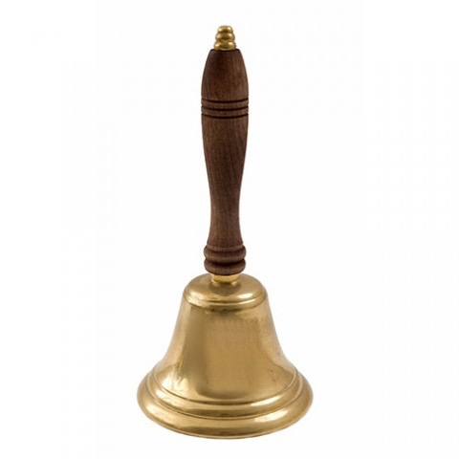
Bell Ringer
Find all 10 errors! Correct them.
The last week of Setpember is Banned books Week. The word banned mean “not alowed.” Many famous books have been banned. Even the popular Harry Potter series was banned in some schools and librarys. Judith Krug, a librarians and activist, beleived people should read whatever they wanted She launched the first Banned Books Weak in 1982. We have celebrated it ever sense.

Slide 2
What should I have completed?
ALL columns in the KWL chart
TWO or more annotated, credible sources
An Introduction

Slide 3
OBJECTIVE FOR TODAY
Today, we will learn how to use in-text citations and how to create body paragraphs.

Slide 4
OBJECTIVE for this week!
This week, we will learn how to do:
In-text citations
Body paragraphs
Conclusions
Work Cited pages
In order to complete our rough drafts!

Slide 5
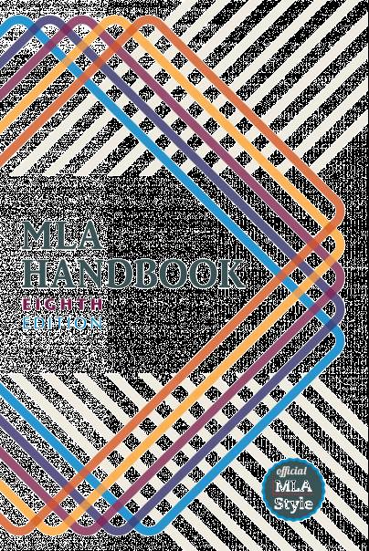
What is MLA?
MLA (Modern Language Association) Style formatting is often used in various humanities disciplines.
In addition to the handbook, MLA also offers The MLA Style Center, a website that provides additional instruction and resources for writing and formatting academic papers. https://style.mla.org/
Notes:
The MLA Handbook for Writers of Research Papers, 8th ed. supersedes both the 7th edition handbook and the MLA Style Manual and Guide to Scholarly Publishing, 3rd ed. The style of documentation outlined in the 8th edition serves the needs of students who are writing research papers, as well as scholars who publish professionally. This presentation will mostly focus on MLA formatting and style concerns that affect writing research papers.
MLA style is often used in the following disciplines: humanities, languages, literature, linguistics, philosophy, communication, religion, and others.
MLA format provides writers with a uniform format for document layout and documenting sources. Proper MLA style shows that writers are conscientious of the standards of writing in their respective disciplines. Properly documenting sources also ensures that an author is not plagiarizing.

Slide 6
What does MLA regulate?
MLA regulates:
document format
in-text citations
works-cited list
Notes:
This slide presents three basic areas regulated by MLA students need to be aware of—document format, in-text citations, and works cited. The following slides provide detailed explanations regarding each area.

Slide 7
Format: General Guidelines
An MLA Style paper should:
Be typed on white 8.5“ x 11“ paper
Double-space everything
Use 12 pt. Times New Roman (or similar) font
Leave only one space after punctuation
Set all margins to 1 inch on all sides
Indent the first line of paragraphs one half-inch
Notes:
The entire document should be double-spaced, including the heading, block quotations, footnotes/endnotes, and list of works cited. There should be no extra space between paragraphs.
Leave only one space after periods or other punctuation marks (unless otherwise instructed by your instructor).
Set the margins of your document to 1 inch on all sides
Indent the first line of paragraphs one half-inch from the left margin. MLA recommends that you use the Tab key as opposed to pushing the Space Bar five times.

Slide 8
Format: General Guidelines (cont.)
An MLA Style paper should:
Have a header with page numbers located in the upper right-hand corner
Use italics for titles
Place endnotes on a separate page before the list of works cited
Notes:
Create a header that numbers all pages consecutively in the upper right-hand corner, one-half inch from the top and flush with the right margin. (Note: Your instructor may ask that you omit the number on your first page. Always follow your instructor's guidelines.)
･Use italics throughout your essay for the titles of longer works
･If you have any endnotes, include them on a separate page before your works-cited list. Title the section Notes (centered, unformatted).

Slide 9
Formatting the 1st Page
The first page of an MLA Style paper will:
Have no title page
Double space everything
List your name, your instructor's name, the course, and date in the upper left-hand corner
Center the paper title (use standard caps but no underlining, italics, quote marks, or bold typeface)
Create a header in the upper right corner at half inch from the top and one inch from the right of the page (list your last name and page number here)
Notes:
･Do not make a title page for your paper unless specifically requested
･In the upper left-hand corner of the first page, list your name, your instructor's name, the course, and the date. Again, be sure to use double-spaced text.
･Double space again and center the title.
Do not underline, italicize, or place your title in quotation marks; write the title in Title Case (standard capitalization), not in all capital letters.
･Use quotation marks and/or italics when referring to other works in your title, just as you would in your text: Fear and Loathing in Las Vegas as Morality Play; Human Weariness in “After Apple Picking“
･Double space between the title and the first line of the text.
･Create a header in the upper right-hand corner that includes your last name, followed by a space with a page number; number all pages consecutively with Arabic numerals (1, 2, 3, 4, etc.), one-half inch from the top and flush with the right margin. (Note: Your instructor or other readers may ask that you omit last name/page number header on your first page. Always follow instructor guidelines.)

Slide 10
Sample 1st Page
Notes:
･Do not make a title page for your paper unless specifically requested
･In the upper left-hand corner of the first page, list your name, your instructor's name, the course, and the date. Again, be sure to use double-spaced text.
･Double space again and center the title.
Do not underline, italicize, or place your title in quotation marks; write the title in Title Case (standard capitalization), not in all capital letters.
･Use quotation marks and/or italics when referring to other works in your title, just as you would in your text: Fear and Loathing in Las Vegas as Morality Play; Human Weariness in “After Apple Picking“
･Double space between the title and the first line of the text.
･Create a header in the upper right-hand corner that includes your last name, followed by a space with a page number; number all pages consecutively with Arabic numerals (1, 2, 3, 4, etc.), one-half inch from the top and flush with the right margin. (Note: Your instructor or other readers may ask that you omit last name/page number header on your first page. Always follow instructor guidelines.)

Slide 11
In-Text Citations: the Basics
An in-text citation is a brief reference in your text that indicates the source you consulted.
It should direct readers to the entry in your works-cited list for that source.
It should be unobtrusive: provide the citation information without interrupting your own text.
In general, the in-text citation will be the author’s last name (or abbreviated title) with a page number, enclosed in parentheses.
Notes:
Basic In-Text Citation Rules
The source information in a parenthetical citation should direct readers to the source’s entry in the works-cited list.
The in-text citation should be placed, if possible, where there is a natural pause in your text. If the citation refers to a direct quotation, it should be placed directly following the closing quotation mark.
Any source information that you provide in-text must correspond to the source information on the works-cited page. More specifically, whatever signal word or phrase you provide to your readers in the text, must be the first thing that appears on the left-hand margin of the corresponding entry in the works-cited list (so the author’s last name or the title, usually, with no punctuation in between)

Slide 12
Author-Page Style
Wordsworth, William. Lyrical Ballads. Oxford UP, 1967.
Notes:
In-Text Citations: Author-Page Style
MLA format follows the author-page method of in-text citation. This means that the author's last name and the page number(s) from which the quotation or paraphrase is taken must appear in the text, and a complete reference should appear in your works-cited page. The author's name may appear either in the sentence itself or in parentheses following the quotation or paraphrase, but the page number(s) should always appear in the parentheses, not in the text of your sentence.
The both citations in the in-text examples on this slide, (263) and (Wordsworth 263), tell readers that the information in the sentence can be located on page 263 of a work by the author, William Wordsworth. If readers want more information about this source, they can turn to the works-cited list, where, under Wordsworth, they would find the information in the corresponding entry also shown on this slide.

Slide 13
Print Source with Author
For the following print source
Burke, Kenneth. Language as Symbolic Action: Essays on Life, Literature,
and Method. U of California P, 1966.
If the essay provides a signal word or phrase—usually the author’s last name—the citation does not need to also include that information.
Notes:
In-text Citations for Print Sources with Known Author
For print sources like books, magazines, scholarly journal articles, and newspapers, provide a signal word or phrase (usually the author’s last name) and a page number. If you provide the signal word/phrase in the sentence, you do not need to include it in the parenthetical citation. These examples must correspond to an entry that begins with Burke, which will be the first thing that appears on the left-hand margin of an entry in the works-cited list (as noted in the corresponding entry on this slide). See comments from previous slide.

Slide 14
With Unknown Author
How to cite a work with no known author:
We see so many global warming hotspots in North America likely because this region has “more readily accessible climatic data and more comprehensive programs to monitor and study environmental change…” (“Impact of Global Warming” 6).
Notes:
In-text Citations for Print Sources with No Known Author
When a source has no known author, use a shortened title of the work instead of an author name. Place the title in quotation marks if it's a short work (e.g. articles) or italicize it if it's a longer work (e.g. plays, books, television shows, entire websites) and provide a page number.
In this example, since the reader does not know the author of the article, an abbreviated title of the article appears in the parenthetical citation which corresponds to the full name of the article which appears first at the left-hand margin of its respective entry in the works-cited list. Thus, the writer includes the title in quotation marks as the signal phrase in the parenthetical citation in order to lead the reader directly to the source on the works-cited page. See comments from previous slide.

Slide 15
Other In-Text Citations 1
Works with Multiple Editions
In-text example:
Marx and Engels described human history as marked by class struggles (79; ch. 1).
Authors with Same Last Names
In-text example:
Although some medical ethicists claim that cloning will lead to designer
children (R. Miller 12), others note that the advantages for medical research outweigh this consideration (A. Miller 46).
Notes:
In parenthetical citations of a literary work available in multiple editions, such as a commonly studied novel, it is often helpful to provide division numbers in addition to page numbers so that your readers can find your references in any edition of the work.
Make sure that your in-text citations refer unambiguously to the entry in your works-cited list. If you are citing from the works of two different authors with the same last name, include the author’s first initial in your reference).

Slide 16
Other In-Text Citations 2
Work by Multiple Authors
In-text Examples:
Smith et al. argues that tougher gun control is not needed in the United States (76).
The authors state: “Tighter gun control in the United States erodes Second Amendment rights” (Smith et al. 76).
A 2016 study suggests that stricter gun control in the United States will significantly prevent accidental shootings (Strong and Ellis 23).
Notes:
Citing a Work by Multiple Authors
If the entry in the works-cited list begins with the names of two authors, include both last names in the in-text citation, connected by and.
If the source has three or more authors, the entry in the works-cited list should begin with the first author’s name followed by et al. The in-text citation should follow suit.

Slide 17
Other In-Text Citations 5
Citing Indirect Sources
In-text example:
Ravitch argues that high schools are pressured to act as “social service centers, and they don't do that well” (qtd. in Weisman 259).
Multiple Citations
In-text example:
Romeo and Juliet presents an opposition between two worlds: “the world of the everyday… and the world of romance.” Although the two lovers are part of the world of romance, their language of love nevertheless becomes “fully responsive to the tang of actuality” (Zender 138, 141).
Notes:
Sometimes you may have to use an indirect source. An indirect source is a source cited in another source. For such indirect quotations, use “qtd. in“ to indicate the source you actually consulted. This is illustrated in the first example on this slide. Note that, in most cases, a responsible researcher will attempt to find the original source, rather than citing an indirect source.
Multiple Citations
If you borrow more than once from the same source within a single paragraph and no other source intervenes, you may give a single parenthetical reference after the last borrowing.

Slide 18
Other In-Text Citations 7
Sources without page numbers
In-text example:
Disability activism should work toward “creating a habitable space for all beings” (Garland-Thomson).
Corresponding works-cited entry:
Garland-Thomson, Rosemarie. “Habitable Worlds.” Critical Disability
Studies Symposium. Feb. 2016, Purdue University, Indiana.
Address.
Notes:
When a source has no page numbers or any other kind of part number, no number should be given in a parenthetical citation. Do not count unnumbered paragraphs, pauses, or other parts. This is an example of how to cite a direct quotation from an oral address.

Slide 19
Bell Ringer
write at least 3 complete sentences.
Should individuals or groups be able to ban or censor books from teenagers?
What types of books should students read or not read in school?

Slide 20
Entry Ticket
Head your paper correctly, including putting your heading in the right location.
What type of spacing does MLA use?
How do I cite something with no page numbers?
What is wrong with the following citation? : In The Jungle, Sinclair writes, “If we are the greatest nation the sun ever shone upon, it would seem to be mainly because we have been able to goad our wage-earners to this pitch of frenzy” (5.)
How do I cite something with multiple authors?
Bonus: What does et al mean?

Slide 21
Before we start those body paragraphs…Let’s talk thesis statement
Your thesis is more than a general statement about your main idea. It needs to establish a clear position you will support with balanced proofs (logos, pathos, ethos).

Slide 22
A Thesis is Not…
A thesis is not a title: Homes and schools (title) vs. Parents ought to participate more in the education of their children (good thesis).
A thesis is not an announcement of the subject: My subject is the incompetence of the Supreme Court vs. The Supreme Court made a mistake when it ruled in favor of George W. Bush in the 2000 election.
A thesis is not a statement of absolute fact: Jane Austen is the author of Pride and Prejudice.
A thesis is not the whole essay: A thesis is your main idea expressed in a single sentence or a combination of sentences.

Slide 23
So what IS a Thesis Statement?
According to the MLA Handbook for Writers of Research Papers, Seventh Edition, "A thesis statement is a single sentence that formulates both your topic and your point of view" (Gibaldi 42). However, if your paper is more complex and requires a thesis statement, your thesis may require a combination of sentences.

Slide 24
The Teacher’s Thesis Statement
The United States government should legalize marijuana because it has medicinal benefits, it is not an addictive drug, and it could then be regulated and taxed by government agencies.

Slide 25
Body Paragraphs
For all 3 body paragraphs, basically all you do is…
Claim!
Cite!
Clarify!
You’re just using citations from your research instead of citations from a story.
We’re adding ONE new element here!

Slide 26
The four elements of a good paragraph (TTEB)
A Transition sentence leading in from a previous paragraph to assure smooth reading. This acts as a hand off from one idea to the next.
A Topic sentence that tells the reader what you will be discussing in the paragraph. (claim- comes from body paragraph.)
Specific Evidence and analysis that supports one of your claims and that provides a deeper level of detail than your topic sentence.(cite)
A Brief wrap-up sentence that tells the reader how and why this information supports the paper’s thesis. (clarify)

Slide 27
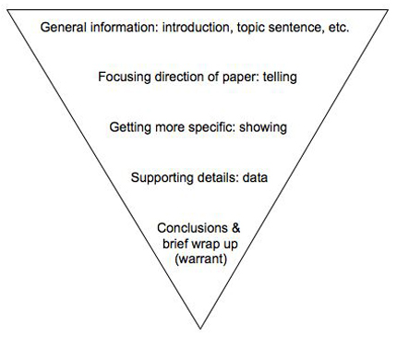
Body paragraphs: Moving from general to specific information

Slide 28
Transition Sentence
Good transitions can connect paragraphs and turn disconnected writing into a unified whole.
Instead of treating paragraphs as separate ideas, transitions can help readers understand how paragraphs work together, reference one another, and build to a larger point.
The key to producing good transitions is highlighting connections between corresponding paragraphs.
By referencing in one paragraph the relevant material from previous paragraphs, writers can develop important points for their readers.

Slide 29
Transitions
It is a good idea to continue one paragraph where another leaves off. (Instances where this is especially challenging may suggest that the paragraphs don't belong together at all.)
Picking up key phrases from the previous paragraph and highlighting them in the next can create an obvious progression for readers.
Many times, it only takes a few words to draw these connections.

Slide 30
Transitional Phrases
To Add:
and, again, and then, besides, equally important, finally, further, furthermore, nor, too, next, lastly, what's more, moreover, in addition, first (second, etc.)
To Compare:
whereas, but, yet, on the other hand, however, nevertheless, on the contrary, by comparison, where, compared to, up against, balanced against, vis a vis, but, although, conversely, meanwhile, after all, in contrast, although this may be true
To Prove:
because, for, since, for the same reason, obviously, evidently, furthermore, moreover, besides, indeed, in fact, in addition, in any case, that is

Slide 31
More Transitional Phrases
To Show Exception:
yet, still, however, nevertheless, in spite of, despite, of course, once in a while, sometimes
To Show Time:
immediately, thereafter, soon, after a few hours, finally, then, later, previously, formerly, first (second, etc.), next, and then
To Repeat:
in brief, as I have said, as I have noted, as has been noted

Slide 32
`
To Emphasize:
definitely, extremely, obviously, in fact, indeed, in any case, absolutely, positively, naturally, surprisingly, always, forever, perennially, eternally, never, emphatically, unquestionably, without a doubt, certainly, undeniably, without reservation
To Show Sequence:
first, second, third, and so forth. A, B, C, and so forth. next, then, following this, at this time, now, at this point, after, afterward, subsequently, finally, consequently, previously, before this, simultaneously, concurrently, thus, therefore, hence, next, and then, soon

Slide 33
More Transitional Phrases
To Give an Example:
for example, for instance, in this case, in another case, on this occasion, in this situation, take the case of, to demonstrate, to illustrate, as an illustration, to illustrate
To Summarize or Conclude:
in brief, on the whole, summing up, to conclude, in conclusion, as I have shown, as I have said, hence, therefore, accordingly, thus, as a result, consequently

Slide 34
My Example
There are several benefits to legalizing marijuana but perhaps one of the greatest advantages is the medicinal purposes it could serve. Marijuana has been shown to help with all of the following: patients suffering from the effects of chemotherapy, multiple sclerosis, epilepsy, concussions, alzheimer’s disease, and much more. For example, Charlotte Figi, a young girl with a rare seizure disorder, was treated with medical marijuana that had been stripped of THC when her parents and doctors could find no other way to stop her seizures. These seizures were causing swift cognitive decline and would eventually kill her. Her father said of the treatment, “I literally see Charlotte's brain making connections that haven't been made in years,” Matt said. "My thought now is, why were we the ones that had to go out and find this cure? This natural cure? How come a doctor didn't know about this? How come they didn't make me aware of this?” (Young 3). It took the Gigi’s months to find doctors who would sign off on this treatment because of the stigma surrounding the drug, but it has been Charlotte Figi’s saving grace, allowing her to live a normal life. The U.S. government should legalize marijuana because there are many more children and adults like Charlotte who could live better lives with the treatment of medicinal marijuana.

Slide 35
My Example
There are several benefits to legalizing marijuana but perhaps one of the greatest advantages is the medicinal purposes it could serve. Marijuana has been shown to help with all of the following: patients suffering from the effects of chemotherapy, multiple sclerosis, epilepsy, concussions, alzheimer’s disease, and much more. For example, Charlotte Figi, a young girl with a rare seizure disorder, was treated with medical marijuana that had been stripped of THC when her parents and doctors could find no other way to stop her seizures. These seizures were causing swift cognitive decline and would eventually kill her. Her father said of the treatment, “I literally see Charlotte's brain making connections that haven't been made in years,” Matt said. "My thought now is, why were we the ones that had to go out and find this cure? This natural cure? How come a doctor didn't know about this? How come they didn't make me aware of this?” (qtd. in Young 3). It took the Figi’s months to find doctors who would sign off on this treatment because of the stigma surrounding the drug, but it has been Charlotte Figi’s saving grace, allowing her to live a normal life. The U.S. government should legalize marijuana because there are many more children and adults like Charlotte who could live better lives with the treatment of medicinal marijuana.

Slide 36
Now it’s your turn!
Draft your body paragraphs using the C.C.C. method.
Make sure to do your in-text citations properly!
If you get stuck, then please do NOT be afraid to ask for help!!!
If you finish, then bring your writing to Ms. Schwartz for review.

